Slide 1
New Spectrum E Tools
Clear Contours
Contour from Coverage

Slide 2
Note on problems faced today using contours
Where Regions are still using R6602 (or other such as OHD) contours, there is the issue of just how very inaccurate those curves are
Also, defining the coverage area to match the R6602 contours is a callange. Many regions use Geo boundaries plus 3 miles
This leads to over protection of incumbants and less efficient reuse of the spectrum

Slide 3
Clear Contours
Select object(s) you want to clear the contours on the Map
Then click on Clear Contours

Slide 4
Contour from coverage
This tool allows a contour to be fitted to a matrix (Longley/Rice ITM) study
This can result in a more accurate coverage or Interference Contour than using R6602 contours. This is especially true for hilly/mountainous terrain
Two Step process
  Run the Longley Rice path loss study for a site(s)
  Then run the Coverage to Contour tool

Slide 5
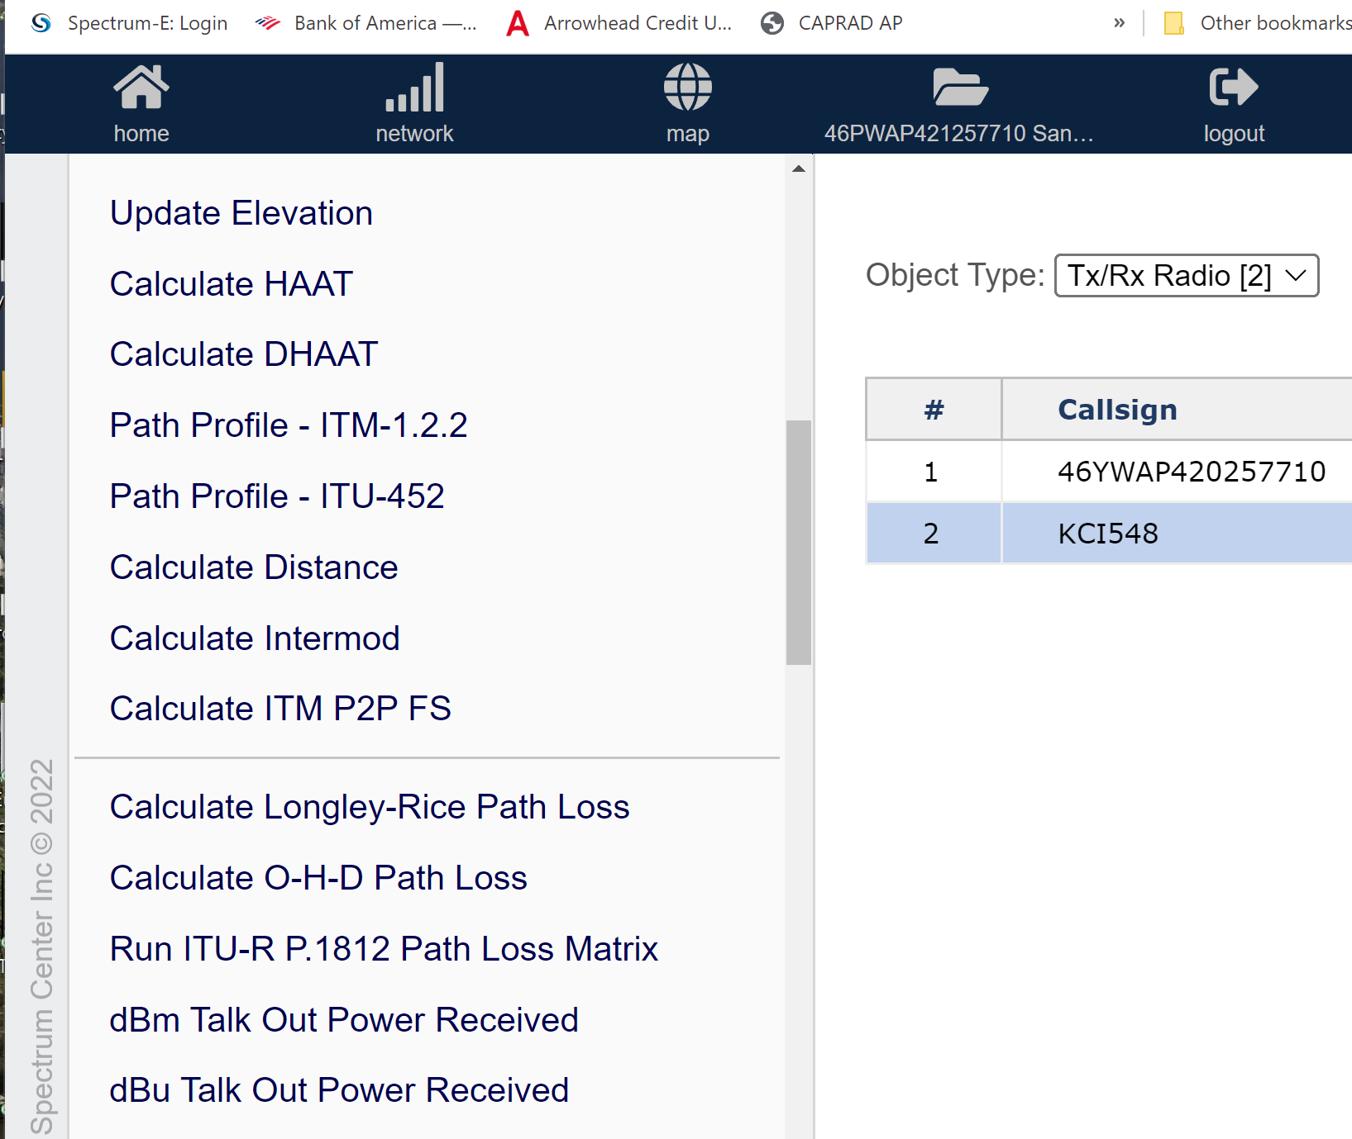
Contour from coverage
First Select – Calculate Longley-Rice Path Loss and run it
For interference analysis TSB- 88 recommends these settings:
  Rx antenna Height – 2 meters
  Confidence 50%
  Reliability 50%
  Grd Type - Ave Grd
  Radio Climate – Cont. Temperate
  Clutter Atten. - None

Slide 6
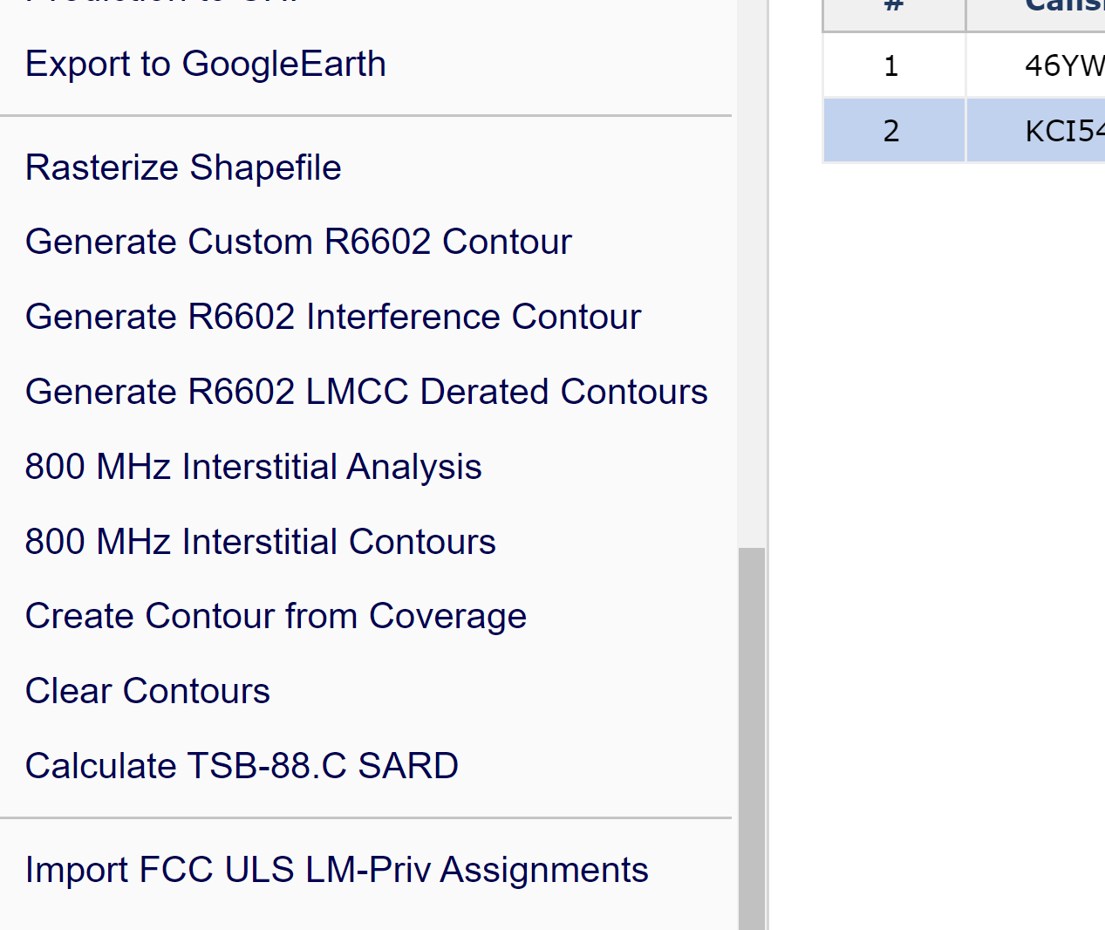
Contour from coverage
Next Select the site for the contour
Next Select Create Contour from Coverage
Settings are:
  Threshold – set to coverage or interference value (example 40 dBu for 800 MHz)
  Reliability – 99%
  Distance Factor – 100%
Note on reliability – This can vary depends on the matrix signal levels. It helps to calculate the dBu or dBm talk out predictions and display on map to get best contour Fit.

Slide 7
